Slide 1
E-R Diagram II
Multi-way Relationships
Ting Zhang

Slide 2
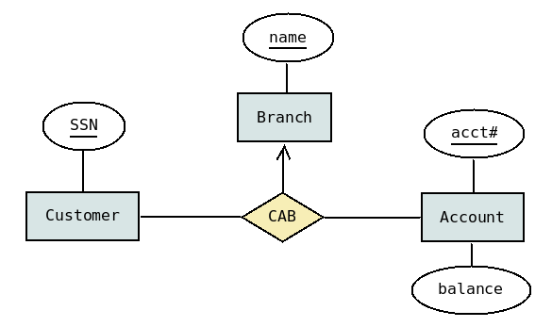
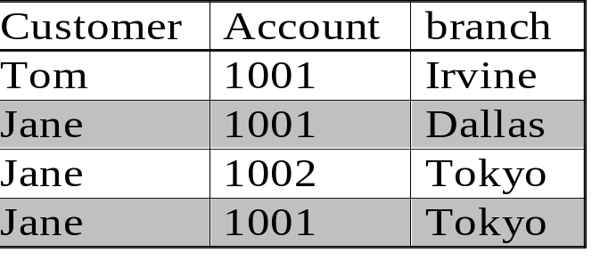
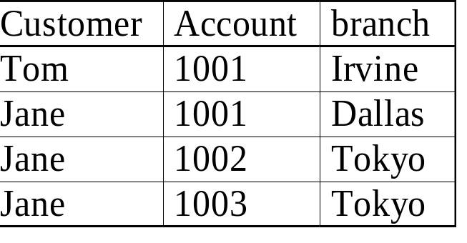
Cardinality Constraints over Multi-way Relationships
Illegal:
Jane has account 1001 at 2 branches
Legal
many-to-many-to-1 relationship
Each (customer, account) determines the branch.

Slide 3
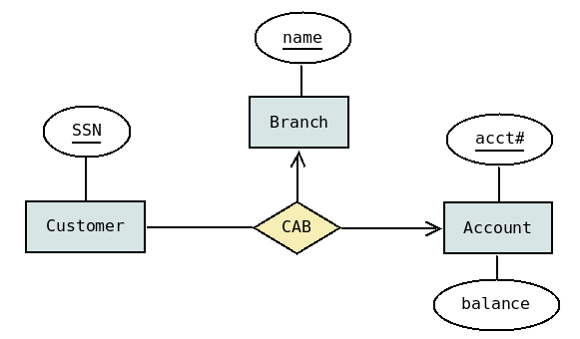
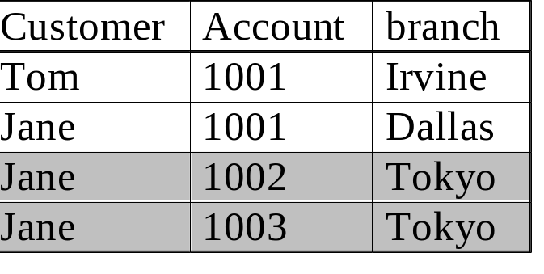
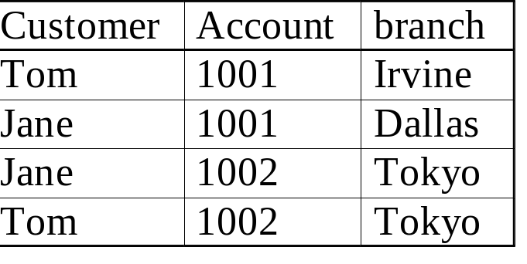
Cardinality Constraints over Multi-way Relationships
Illegal: Jane has 2 accounts in Tokyo Branch
Legal
many-to-1-to-1 relationship
Meaning:
  Each (customer, branch) related to a single account
  Each (customer, account) pair related to a single branch

Slide 4
Exercise #1
Change this E/R diagram so that for
every baby there is a unique mother.
Mothers
Babies
births
Nurses
Doctors

Slide 5
Solution #1
baby_of
Mothers
Babies
births
Nurses
Doctors

Slide 6
Exercise #2
Change this E/R diagram so that for every combination of baby,
Nurse, and doctor there is a unique mother.
Mothers
Babies
births
Nurses
Doctors

Slide 7
Solution #2
Mothers
Babies
births
Nurses
Doctors

Slide 8
Exercise #3
Change this E/R diagram so that for every combination of a baby and
a mother, there is a unique doctor.
Mothers
Babies
births
Nurses
Doctors

Slide 9
Solution #3
Mothers
Babies
births
Nurses
works_as_
pediatrician
Doctors

Slide 10
Exercise #4
Change this E/R diagram so that every baby is the result of
a unique birth and every birth is of a unique baby
Births
Babies
Mothers
Doctors
Nurses

Slide 11
Solution #4
Births
Babies
Mothers
Doctors
Nurses

Slide 12
Exercise #5
Further change this E/R diagram so that every baby has a
unique mother.
Births
Babies
Mothers
Doctors
Nurses

Slide 13
Solution #5-1
Births
Babies
Mothers
Doctors
Nurses

Slide 14
Solution #5-2
Births
Babies
Mothers
Doctors
Nurses
baby_of

Slide 15
Exercise #6
Further change this E/R diagram so that for every birth there is
a unique doctor.
Births
Babies
Mothers
Doctors
Nurses
baby_of

Slide 16
Solution #6
Births
Babies
Mothers
Doctors
Nurses
baby_of

Slide 17


Multi-ways relationships
Finding illegal instances is a good way to better understand MWR
Convert E/R to Relations

